Slide 1
Guardian of Decency
Uva 12083
NWERC 2005, LA3415
3 seconds

Slide 2
Problem Descriptions (1/2)
Frank N. Stein is a very conservative high-school teacher. He wants to take some of his students on an excursion, but he is afraid that some of them might become couples. While you can never exclude this possibility, he has made some rules that he thinks indicates a low probability two persons will become a couple:

Slide 3
Problem Descriptions (2/2)
Their height differs by more than 40 cm.
They are of the same sex.
Their preferred music style is different.
Their favorite sport is the same (they are likely to be fans of different teams and that would result in fighting).
So, for any two persons that he brings on the excursion, they must satisfy at least one of the requirements above.
Help him find the maximum number of persons he can take, given their vital information.

Slide 4
Input
The first line of the input consists of an integer T ≤ 100 giving the number of test cases.
The first line of each test case consists of an integer N ≤ 500 giving the number of pupils.
Next there will be one line for each pupil consisting of four space-separated data items:
an integer h giving the height in cm
a character ‘F’ for female or ‘M’ for male
a string describing the preferred music style
a string with the name of the favorite sport
■No string in the input will contain more than 100 characters, nor will any string contain any whitespace.

Slide 5
Output
For each test case in the input there should be one line with an integer giving the maximum number of eligible pupils.

Slide 6

I/O Example
Number of test cases
7
Number of pupils
1
8
27 M romance programming
194 F baroque programming
67 M baroque ping-pong
51 M classicism programming
80 M classicism Paintball
35 M baroque ping-pong
39 F romance ping-pong
110 M romance Paintball
height gender music-style favorite-sport
0
1
2
6
3
只能二選一
4
5
7

Slide 7
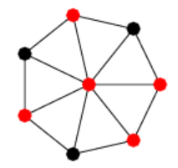
Min Vertex Cover (Red)
a minimum vertex cover of a graph is a minimum set of vertices such that each edge of the graph is incident to at least one vertex of the set.

Slide 8
Max Independent Set (Black)
In the maximal independent set (MIS) of a graph, there is no vertex outside the independent set that may join it.

Slide 9
MaxIS v.s. MinVC is Complementary (互補)

Slide 10
Bipartite Graph
min vertex cover
1
A
max_match=4
11-4=7
2
B
max independent set
3
C
4
D
5
E
6

Slide 11
Example 1
27 M romance programming
0
1
194 F baroque programming
67 M baroque ping-pong
2
6
39 F romance ping-pong
51 M classicism programming
3
80 M classicism Paintball
4
max_match=1
ans=N-max_match
7 = 8 - 1
35 M baroque ping-pong
5
110 M romance Paintball
7

Slide 12
Example 2
27 M romance programming
1
2
40 F romance ping-pong
67 M romance programming
3
7
39 F romance ping-pong
51 M classicism programming
4
80 M classicism Paintball
5
max_match=2
ans=N-max_match
35 M romance programming
6
50 M romance Paintball
8

Slide 13
Perfect Bipartite Matching
Argument Path
1
A
1
A
1
A
2
B
2
B
2
B
3
C
3
C
3
C
4
D
4
D
4
D
5
E
5
E
5
E

Slide 14
Perfect Bipartite Matching
4
D
3
A
1
B
4
D
3
A
1
B
1
A
1
A
1
A
2
B
2
B
2
B
3
C
3
C
3
C
4
D
4
D
4
D
5
E
5
E

Slide 15
Perfect Bipartite Matching
Perfect Matching
Not Perfect Matching
1
A
1
A
2
B
if
2
B
5

E
3
C
3
C
4
D
4
D
5
E
5
E
From Node 5,
we cannot find an Argument Path

Slide 16
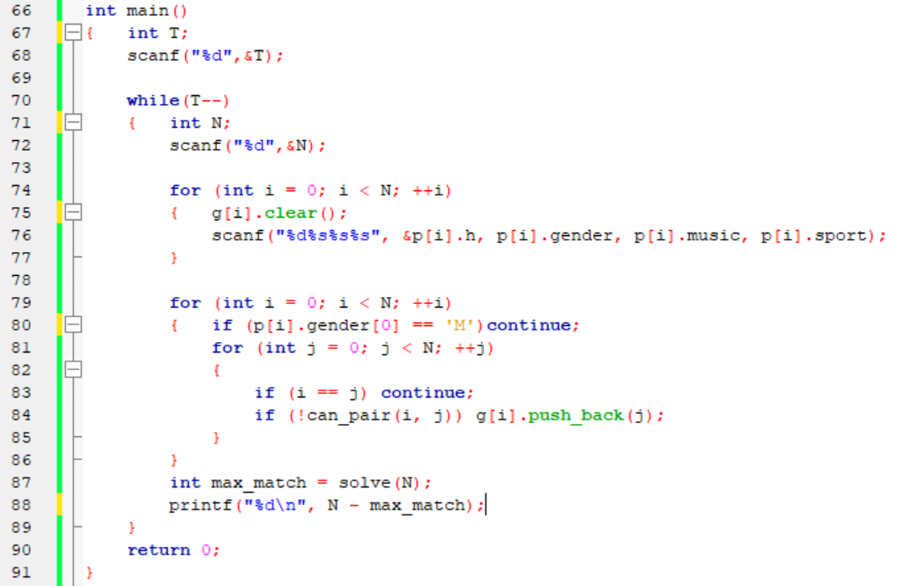

Slide 17
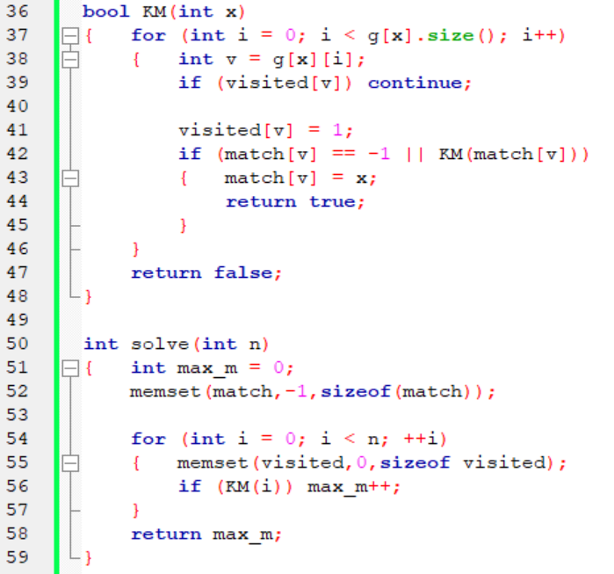

Slide 18
